Slide 1
Welcome!
ZHENZHONG LIANG
Notes:
© Copyright Showeet.com – Creative & Free PowerPoint Templates

Slide 2
How Shin'ichiro Watanabe makes animation with multiculturalism
ZHENZHONG LIANG
———The Case of <Cowboy Bebop> and <Samurai Champloo>
Notes:
© Copyright Showeet.com – Creative & Free PowerPoint Templates

Slide 3
Main Content
01
Who is Shin'ichirō Watanabe
04
Linking in irrelevant elements
02
Borderless animation
05
Summary
03
Narrow nationalism
Notes:
© Copyright Showeet.com – Creative & Free PowerPoint Templates

Slide 4
About Shin'ichirō Watanabe
ZHENZHONG LIANG
The "Quentin Tarantino of anime"
Notes:
© Copyright Showeet.com – Creative & Free PowerPoint Templates

Slide 5
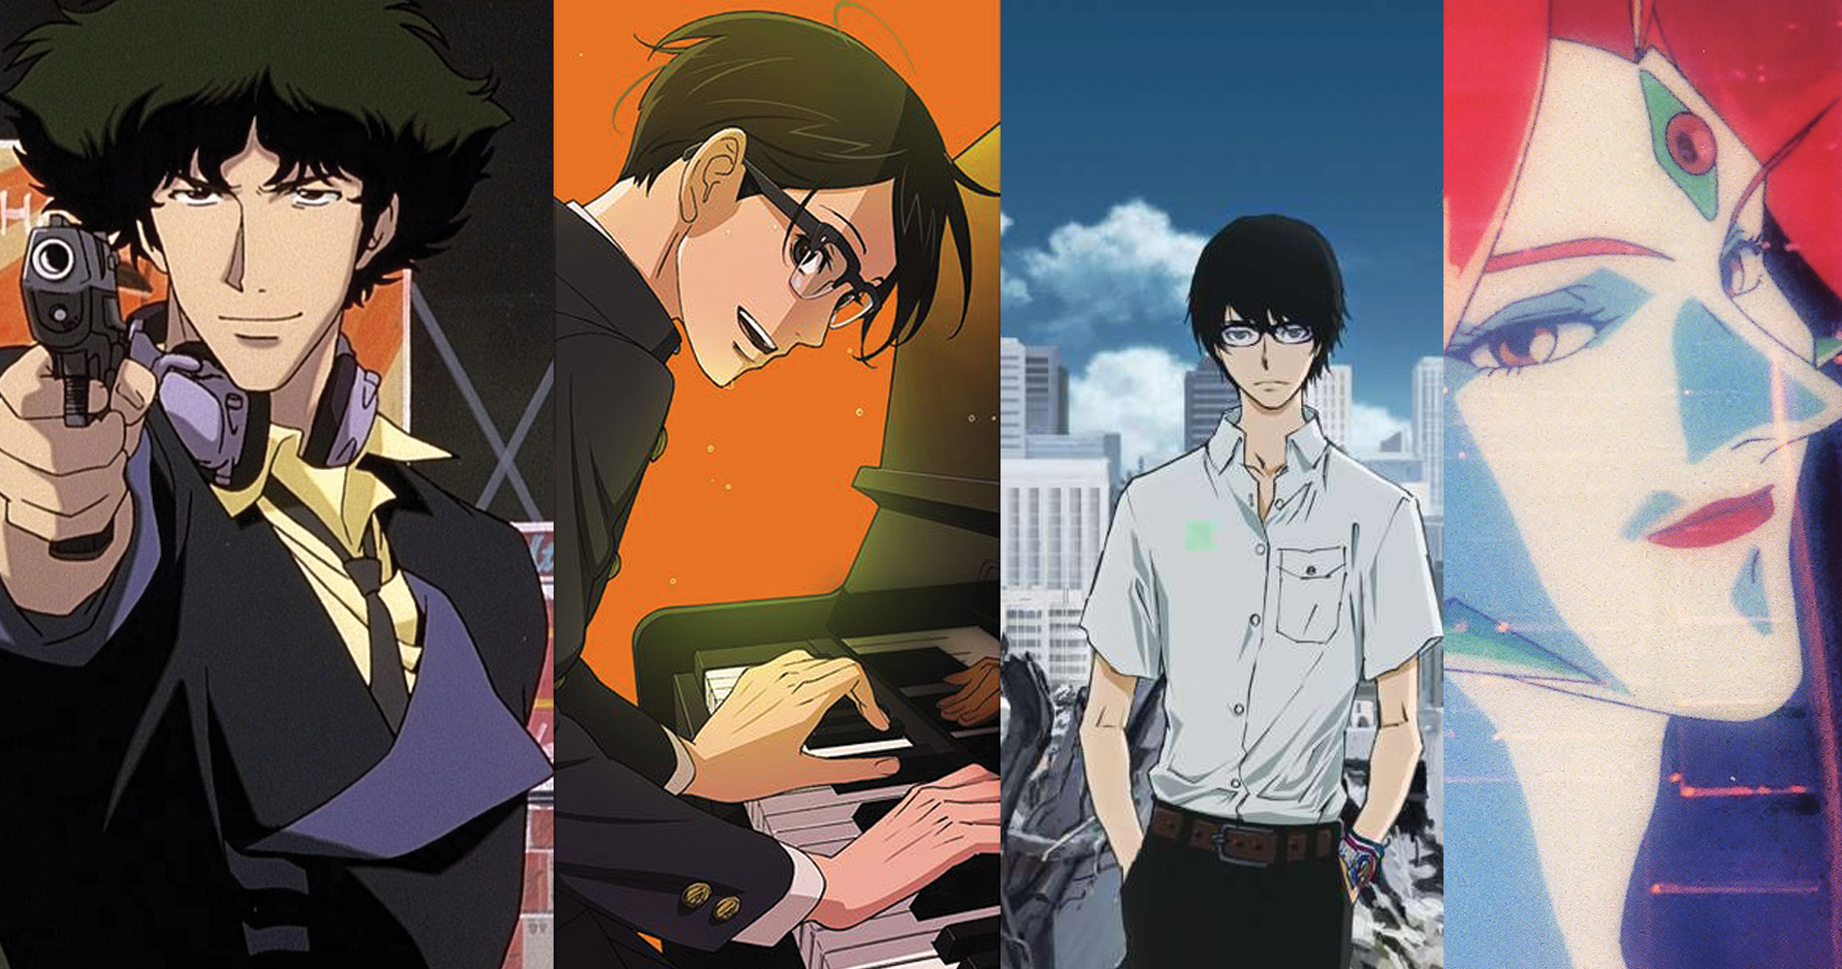
Shin'ichirō Watanabe
01
Career Experience
Major Masterpieces
Main style of works
Notes:
© Copyright Showeet.com – Creative & Free PowerPoint Templates

Slide 6
Career Experience
Watanabe was born in Kyoto on 1965 and joined in the Sunrise studio as a producer.
In 1994 he got a chance to make a animation for <Macross Plus>.
His first full-length animation TV <Cowboy Bebop> came out on 1998.
As a co-producer for The Wachowskis' <The Animatrix> on 2003.
<Samurai Champloo> was directed by him on 2004 which is also one of his masterpieces.
He has been conutinuly working in animation industry, and has a regular annual output.
Notes:
© Copyright Showeet.com – Creative & Free PowerPoint Templates

Slide 7
Borderless Animation
ZHENZHONG LIANG
“Postmodernist creators don't make rules is to make them regulated.”
Notes:
© Copyright Showeet.com – Creative & Free PowerPoint Templates

Slide 8
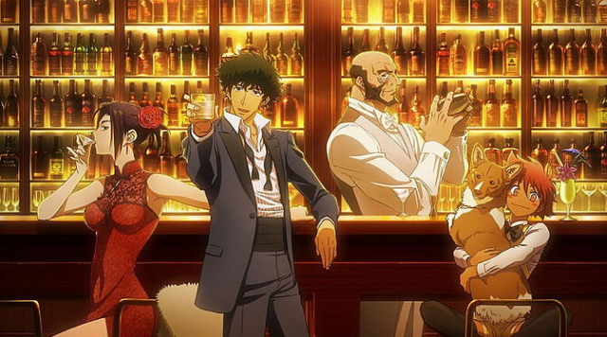
Postmodernist’s rule is no rule
02
Design things from small point.
Get inspirations from interests .
Ignoring industry rules.
Notes:
© Copyright Showeet.com – Creative & Free PowerPoint Templates

Slide 9
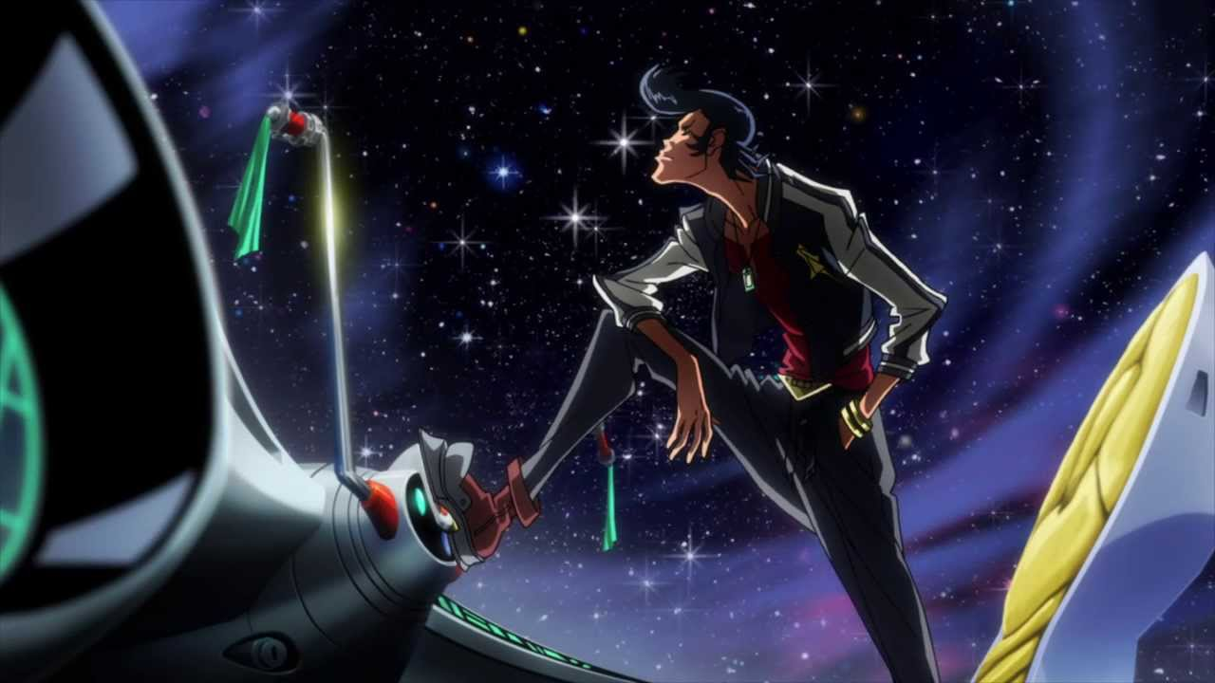
Narrow nationlism
ZHENZHONG LIANG
Notes:
© Copyright Showeet.com – Creative & Free PowerPoint Templates

Slide 10
Anti-nationlism
Characters and sets from the anime Mukokuseki rely on the transparency of white to create a surrogate ANationality, a "normal" animation, a metaphor for white American and European visual culture endorses the versatility of animation.
Watanabe's work focuses more on the free, nature, romantic stories of minority groups and marginalized areas.
Watanabe's claims that “national borders have always been arbitrarily drawn.” In his work, the audience could feel a sense of sadness that is both familiar and unfamiliar.
All these facts constitute a sense of solitude beyond the nation and reality.
Notes:
© Copyright Showeet.com – Creative & Free PowerPoint Templates

Slide 11
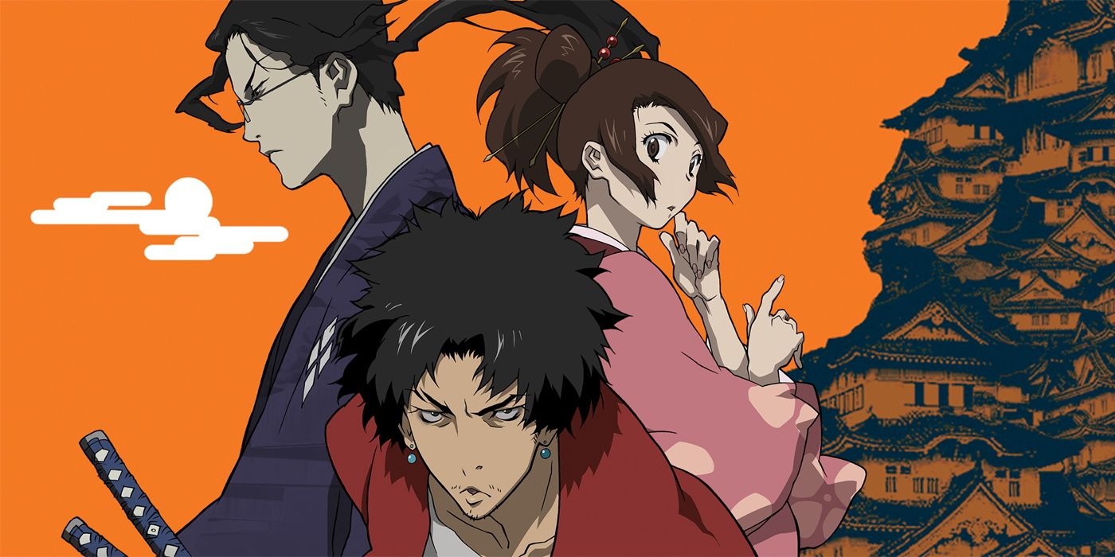
Linking in irrelevant elements
ZHENZHONG LIANG
Notes:
© Copyright Showeet.com – Creative & Free PowerPoint Templates

Slide 12
Choosing unusual elements
Watanabe's diverse use of multiple genres of music in his editing work to strengthen narrative.
Notes:
© Copyright Showeet.com – Creative & Free PowerPoint Templates

Slide 13
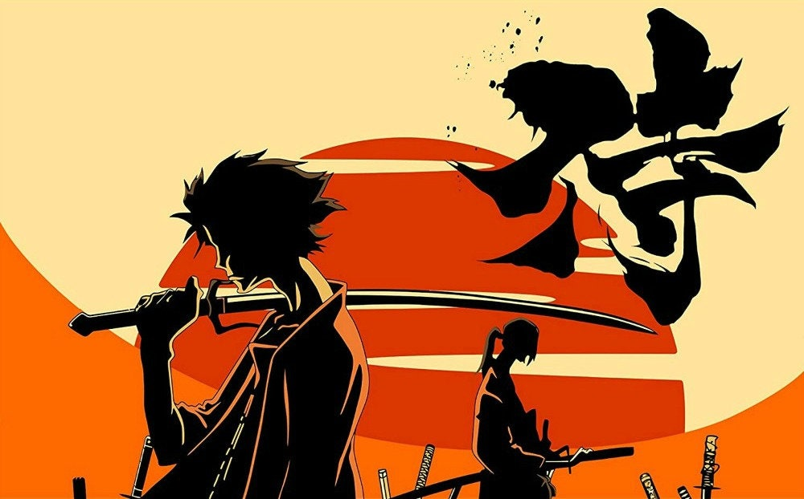
Summary
ZHENZHONG LIANG
Notes:
© Copyright Showeet.com – Creative & Free PowerPoint Templates

Slide 14
Sets few limitation
Staying liberal
linking irrelevant elements
Zhenzhong Liang
Notes:
© Copyright Showeet.com – Creative & Free PowerPoint Templates

Slide 15
Thank You!
ZHENZHONG LIANG
Photo credit: PeterArreola via Pixabay (Creative Commons Zero license)
Notes:
© Copyright Showeet.com – Creative & Free PowerPoint Templates

